Slide 1
Kaggle Movie Reviews Sentiment Analysis and Feature Extraction
Bryan D’Amico, Matthew Smith, and Sintia Stabel

Slide 2
About the Data
Kaggle Movie Review Data
Data frame containing reviews and multiple partial phrases of each review
All phrases are assigned a sentiment: negative, somewhat negative, neutral, somewhat positive, positive numbered 0 through 4
Focused on full reviews
8529 entries
Balanced data, all 5 sentiment categories well represented

Slide 3
Traditional NLTK Analysis
Attempt to classify the sentiment of the reviews by creating feature sets to train the NLTK Naïve Bayes classifier on
Data Processing
Extract unique full reviews from Kaggle data set
Create two new sets of reviews
Reviews with original sentiment labels (0-4)
Reviews with modified sentiment labels (1-3)
Tokenization
Lower-case
Lemmatization
Randomization in preparation for training and testing

Slide 4
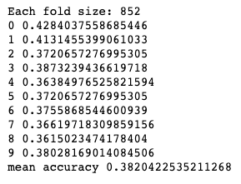
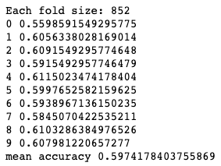
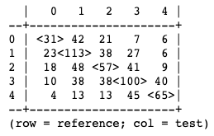
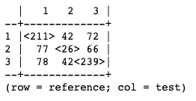
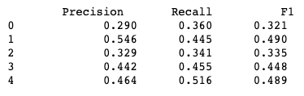

Experiment 1: Bag of Words
Features: Identifying presence or absence of 2000 most common word tokens
Five Sentiment Reviews
Three Sentiment Reviews
Single Evaluation
Confusion Matrix
10-fold Cross Validation
Single Evaluation
Confusion Matrix
10-fold Cross Validation
Additional Metrics
Additional Metrics
Just using the bag of word feature sets was not informative enough for the classifier. Many mistakes were made when trying
to classify the negative and neutral reviews. Overall, classifier performance was not sufficient.

Slide 5
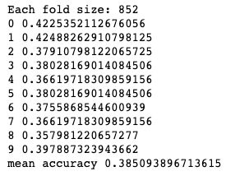
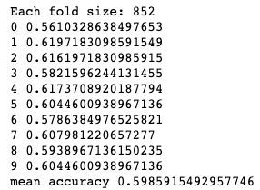
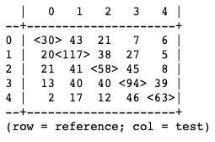
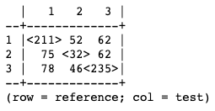
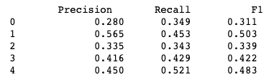

Experiment 2: Bag of Words and Length
Features: Identifying presence or absence of 2000 most common word tokens and length of review measured by number of characters
Five Sentiment Reviews
Three Sentiment Reviews
Single Evaluation
Confusion Matrix
10-fold Cross Validation
Single Evaluation
Confusion Matrix
10-fold Cross Validation
Additional Metrics
Additional Metrics
The classifier did not find length to be a particularly informative feature. The performance of the classifier is almost
identical to the results of the previous experiment.

Slide 6
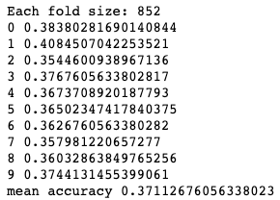
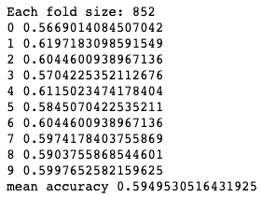
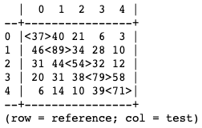
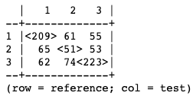
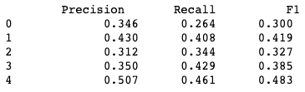

Experiment 3: Common Negation Words
Features: Identifying presence or absence of 2000 most common word tokens and indication of word being negative through presence of negation word
Five Sentiment Reviews
Three Sentiment Reviews
Single Evaluation
Confusion Matrix
10-fold Cross Validation
Single Evaluation
Confusion Matrix
10-fold Cross Validation
Additional Metrics
Additional Metrics
Negation features did not help the classifier understand the sentiments of the reviews better. The accuracy for the five
sentiment reviews saw a slight decrease. Still having most trouble with neutral reviews.

Slide 7
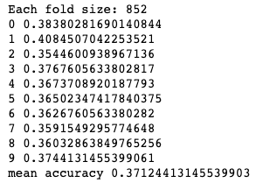
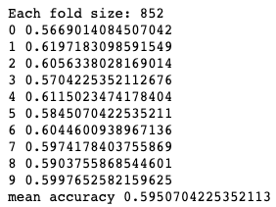
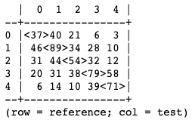
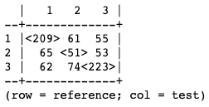
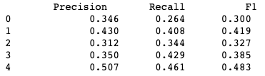

Experiment 4: Extended Negation Words
Features: Identifying presence or absence of 2000 most common word tokens and indication of word being negative through presence of negation word using an extended list
Five Sentiment Reviews
Three Sentiment Reviews
Single Evaluation
Confusion Matrix
10-fold Cross Validation
Single Evaluation
Confusion Matrix
10-fold Cross Validation
Additional Metrics
Additional Metrics
Identical confusion matrices when compared to the previous experiment indicate that the classifier did not make use of
the additional negation words. Performance of the classifier was unchanged.

Slide 8
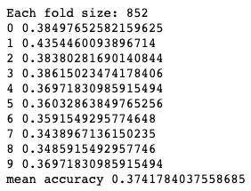
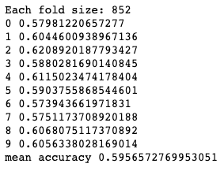
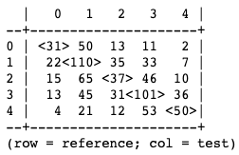
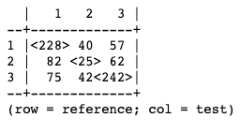
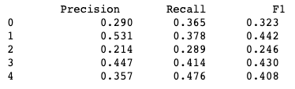

Experiment 5: Removing Stopwords
Features: Identifying presence or absence of 2000 most common word tokens excluding NLTK stopwords
Five Sentiment Reviews
Three Sentiment Reviews
Single Evaluation
Confusion Matrix
10-fold Cross Validation
Single Evaluation
Confusion Matrix
10-fold Cross Validation
Additional Metrics
Additional Metrics
Focusing on the content words of the reviews did not improve performance. Classifier especially struggled with
neutral reviews. Greater disparity between accuracies during cross validations.

Slide 9
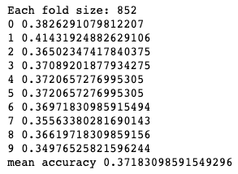
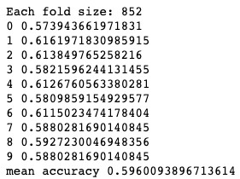
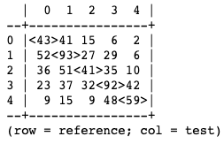
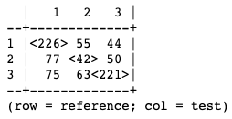
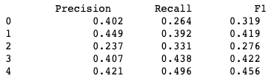

Experiment 6: Extended Negation Words and Removing Stopwords
Features: Identifying presence or absence of 2000 most common word tokens excluding NLTK stopwords and indication of word being negative through presence of negation word using an extended list
Five Sentiment Reviews
Three Sentiment Reviews
Single Evaluation
Confusion Matrix
10-fold Cross Validation
Single Evaluation
Confusion Matrix
10-fold Cross Validation
Additional Metrics
Additional Metrics
Combining the feature sets of experiments 4 and 5 did not make the classifier more informed through the training process.
Classifier still displays the same weaknesses, especially regarding the neutral sentiment.

Slide 10
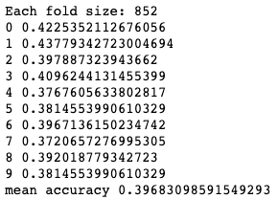
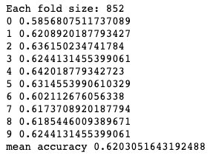
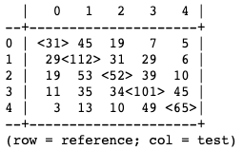
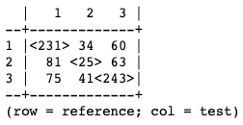
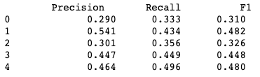

Experiment 7: Word Subjectivity
Features: Identifying presence or absence of 2000 most common word tokens along with positive and negative ratings based on words identified in the subjectivity lexicon
Five Sentiment Reviews
Three Sentiment Reviews
Single Evaluation
Confusion Matrix
10-fold Cross Validation
Single Evaluation
Confusion Matrix
10-fold Cross Validation
Additional Metrics
Additional Metrics
Performance of the classifier on the five sentiment reviews was similar to other experiments. Performance on the three
sentiment reviews showed slight improvement, despite even more issues with neutral reviews.

Slide 11
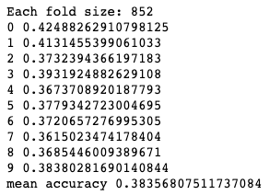
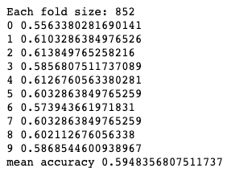
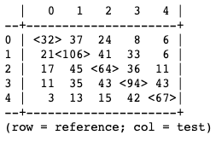
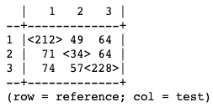
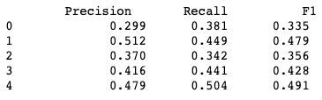

Experiment 8: Parts of Speech
Features: Identifying presence or absence of 2000 most common word tokens along with counts of nouns, verbs, adjectives, and adverbs
Five Sentiment Reviews
Three Sentiment Reviews
Single Evaluation
Confusion Matrix
10-fold Cross Validation
Single Evaluation
Confusion Matrix
10-fold Cross Validation
Additional Metrics
Additional Metrics
Similar performance to all other classifiers, besides word subjectivity. When applied to five sentiment reviews, better
performance with neutral reviews, although worse with negative reviews. Performance against three sentiment reviews still
highlights weakness in relation to neutral reviews.

Slide 12

Experiment 9: TextBlob Sentiment Analysis
TextBlob package converts strings to blob objects
Contain many pieces of information such as parts of speech tags and phrases, subjectivity and polarity scores
No processing required
Raw text strings are given to the TextBlob conversion function
TextBlob sentiment scores were compared to three sentiment labels
TextBlob score greater than 0.05 and positive sentiment is a match
TextBlob score between -0.05 and 0.05 and neutral sentiment is a match
TextBlob score less than -0.05 and negative sentiment is a match
Number of matches determined “accuracy”
Surprised to find match accuracy was the same as Naïve Bayes classifiers accuracies

Slide 13
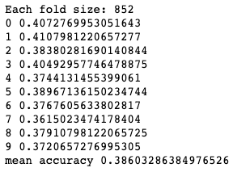
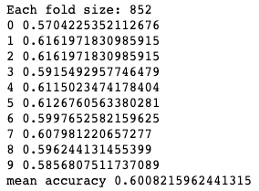
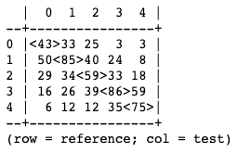
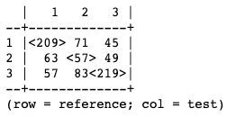


Experiment 10: Multiple Feature Sets
Features: Bag of Words + Extended Negation Words + Part of Speech Tags + Word Subjectivity
Five Sentiment Reviews
Three Sentiment Reviews
Single Evaluation
Confusion Matrix
10-fold Cross Validation
Single Evaluation
Confusion Matrix
10-fold Cross Validation
Additional Metrics
Additional Metrics
Quantity does not equal quality. More features did not result in a more informed classifier. Performance was roughly equal
to any of the classifiers using one of the feature sets. Slight improvement in dealing with neutral reviews.

Slide 14
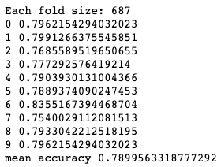
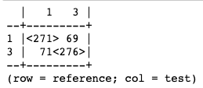

Experiment 11: Two Sentiment Analysis
Want to see performance when weakest aspect removed
Three sentiment review data was filtered to remove all neutral reviews
Full data processing applied
Tokenization, lower case, lemmatization
Applied best performing classifier – word subjectivity features
Classifier performed much better
Single Evaluation
Confusion Matrix
10-fold Cross Validation
Additional Metrics

Slide 15
NLTK Analysis Conclusions
Feature sets did not provide informative enough training data for the Naïve Bayes classifier to handle this task
These methods may not be equipped to handle analyses with several sentiments
Five sentiment review performance was always quite poor
Even a pre-trained model had low accuracy
Potential issue with the way the reviews were tagged
Even humans will disagree on sentiment (somewhat positive vs. positive)
Best suited for a binary classification
Removing neutral reviews showed large performance gains

Slide 16
Data preparation
Lowercase
# Convert text to lowercase
def preprocess_text(text):
text = text.lower()
Punctuation
# Remove special characters and punctuation
text = re.sub(r'[^\w\s]', '', text)
Stopwords
# Remove stopwords
stop_words = set(stopwords.words('english'))
tokens = [token for token in tokens if token not in stop_words]
Lematization
# Lemmatize the tokens
lemmatizer = WordNetLemmatizer()
tokens = [lemmatizer.lemmatize(token) for token in tokens]

Slide 17
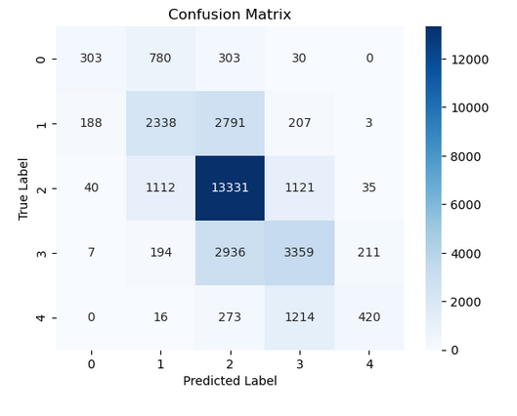
SVM – SVC linear Classifier
Sklearn TfidfVectorizer - feature extraction
Accuracy: 63.28%
# Define the TF-IDF vectorizer
vectorizer = TfidfVectorizer()
# Transform the text data
train_x = vectorizer.fit_transform(train_df['processed_text'])
test_x = vectorizer.transform(test_df['processed_text'])
# Define the labels
train_y = train_df['Sentiment']
test_y = test_df['Sentiment']
# Train the SVM classifier
classifier = svm.SVC(kernel='linear')
classifier.fit(train_x, train_y)

Slide 18
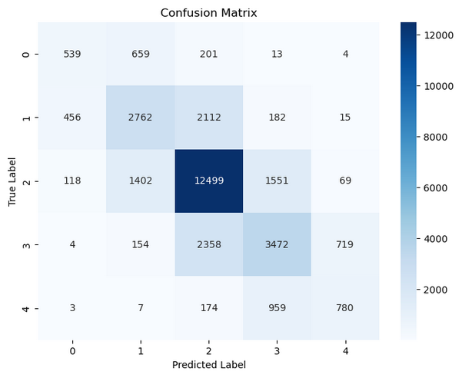
Random forest – Sklearn Ensemble Classifier
Sklearn TfidfVectorizer - feature extraction
Accuracy: 64.24%
# Define the TF-IDF vectorizer
vectorizer = TfidfVectorizer()
# Transform the text data
train_x = vectorizer.fit_transform(train_df['processed_text'])
test_x = vectorizer.transform(test_df['processed_text'])
# Define the labels
train_y = train_df['Sentiment']
test_y = test_df['Sentiment’]
# Train the Random Forest classifier
classifier = RandomForestClassifier(n_estimators=100, random_state=42)
classifier.fit(train_x, train_y)

Slide 19
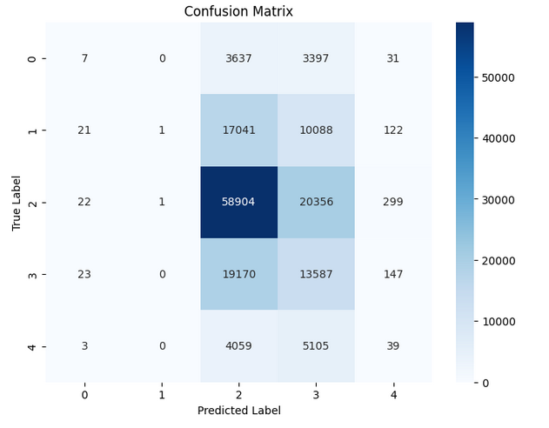
Hugging Face – Bert Sentiment Analysis
Accuracy 46.48%
# Instantiate the tokenizer and sentiment analysis model
tokenize = BertTokenizer.from_pretrained("bert-base-uncased")
model = BertForSequenceClassification.from_pretrained("bert-base-uncased", num_labels=4)
# Create input tensors
inputs = {
"input_ids": torch.tensor([input_ids]),
"attention_mask": torch.tensor([[1] * len(input_ids)]) }
# Perform sentiment analysis
outputs = model(**inputs)
logits = outputs.logits
predicted_label = torch.argmax(logits).item()
predicted_sentiments.append(predicted_label)

Slide 20
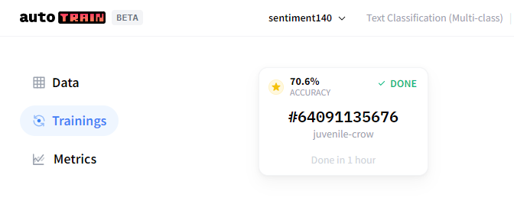

Hugging face – Auto Train BETA

Slide 21


Hugging face – Auto Train Pre-Processed

Slide 22
Conclusions - Additional Models
SVM and Random Forest produced similar accuracy results 63-64% accuracy
NLP Models take a long time to train and consume a lot of computing power
NLP Models require massive amounts of data to be trained properly
Data pre-processing is not helpful in every situation – Transformer architecture being a prime example
Architectures like BERT and Auto NLP do not benefit from lemmatization, special character removal, and stop word removal because they play a role in context

Slide 23
Word Embeddings
Using the `gensim` package to extract word embeddings.
Can determine which words have similar context or meaning with others in a body of text.
In this case, we show how bigrams of words show similar word embedding vectors with one another.

Slide 24

Edge weight = the importance, frequency, or probability of transitioning to one work to the next in a bigram

Slide 25

Word vectors are vectors/lists of floats that are the result of the ML model capturing the semantic features of the words in context of the training corpus.
Interpreting individual dimensions of a word vector isn't straightforward or intuitive, because these numbers aren't associated with clearly identifiable properties of words.
In this example (for expandability) we chose words that are bigrams with each other (and not) to show to differences in the word vectors.
“Feels” Vector
[-6.7992467e-01 8.9688659e-01 -2.5406939e-01 7.9326826e-01 1.7226592e-01 -1.3030788e+00 7.6043135e-01 2.5170207e+00 -1.5367763e+00 -9.6420509e-01 -2.9269642e-01 -1.5140722e+00 -4.6345305e-01 2.0598622e-01 4.2727703e-01 -3.6553320e-01 9.6964747e-01 -7.7319992e-01 -2.9792199e-01 -1.9511813e+00 4.4024709e-01 6.1488414e-01 1.4786688e+00 -8.4639961e-01 1.0157923e-01 -1.7117431e-03 -9.0585536e-01 -6.9817954e-01 -9.1863269e-01 1.3165778e-01 1.9572090e+00 -9.0508752e-02 2.3910373e-01 -2.2383986e+00 -3.9571920e-01 1.7079108e+00 5.9104568e-01 -1.0500346e+00 -6.9620162e-01 -1.5526249e+00 2.6991202e-02 -1.6042304e+00...]

Slide 26


Slide 27

Experiment 1: Logistic Regression with Word Embeddings
def get_avg_word2vec(sentence_list, vector, generate_missing=False, k=100):
if len(sentence_list)<1:
return np.zeros(k)
if generate_missing:
vectorized = [vector[word] if word in vector else np.random.rand(k) for word in sentence_list]
else:
vectorized = [vector[word] if word in vector else np.zeros(k) for word in sentence_list]
length = len(vectorized)
summed = np.sum(vectorized, axis=0)
averaged = np.divide(summed, length)
return averaged
def get_word2vec_embeddings(vectors, df, generate_missing=False):
embeddings = unique_reviews['Phrase'].apply(lambda x: get_avg_word2vec(x, vectors,
generate_missing=generate_missing))
return list(embeddings)
# First, tokenize the reviews
unique_reviews['Phrase'] = unique_reviews['Phrase'].apply(lambda x: word_tokenize(x))
# Generate the embeddings
embeddings = get_word2vec_embeddings(model.wv, unique_reviews)
# Train Test Split
X_train, X_test, y_train, y_test = train_test_split(embeddings, unique_reviews['Sentiment'],
test_size=0.2, random_state=40)
# Training a Logistic Regression model
model = LogisticRegression()
model.fit(X_train, y_train)
# Predicting
y_pred = model.predict(X_test)
# Evaluate the model
print(classification_report(y_test, y_pred))

Slide 28

Experiment 2: Random Forest with Word Embeddings
from sklearn.ensemble import RandomForestClassifier
from sklearn.model_selection import train_test_split
from sklearn.metrics import classification_report
def get_word2vec_embeddings(vectors, clean_questions, generate_missing=False):
embeddings = [get_avg_word2vec(x, vectors, generate_missing=generate_missing) for x in clean_questions]
return embeddings
# Assuming 'model' is your Word2Vec model
embeddings = get_word2vec_embeddings(model.wv, tokenized_sentences)
# Train Test Split
X_train, X_test, y_train, y_test = train_test_split(embeddings, unique_reviews['Sentiment'],
test_size=0.2, random_state=40)
# Convert list of vectors to numpy arrays
X_train = np.array(X_train)
X_test = np.array(X_test)
# Training a Random Forest Classifier model
model = RandomForestClassifier()
model.fit(X_train, y_train)
# Predicting
y_pred = model.predict(X_test)
# Evaluate the model
print(classification_report(y_test, y_pred))

Slide 29
Conclusions – Word Embeddings
Best overall accuracy was approx. 32%
Was not able to capture sentiment categories equally; 0, 2, and 4 had inconsistent results.
Model was able to classify text as sentiment category 1 and 3 at an accuracy rate of 36% and 44%, respectively.
Did not use ‘GloVe’ (Global Vectors for Word Representation) model; another word embeddings model developed by Stanford.

Slide 30
Overall Conclusions
Sentiment analysis (and NLP in general), is a complicated and nuanced field with many approaches.
Even a pre-trained models have low accuracy, depending on the data presented to it
Potential issues come with the way that data is tagged/labeled
Even humans will disagree on sentiment (somewhat positive vs. positive)
Best suited for a binary classification (according to our findings)
Removing neutral reviews showed large performance gains
Data pre-processing is not helpful in every situation

